Slide 1
Group 1: Predictive Statistical Problems Assignment Part 2
Andre R. C. Junior,
Bruno A. L. Sassi,
Luciana A. Q. Popa, and
Tiago C. Ceolato.
Master of Data Analytics, University of Niagara Falls Canada
Predictive Analytics (DAMO-510-1)
Dr. Zeeshan Ahmad
June, 2025
Notes:
Good morning, I am Andre, this is Bruno, Luciana, and Tiago.
In this project, we explored a dataset focused on cigarette and alcohol addiction, aiming to predict individuals’ health risks based on lifestyle and behavioral factors.

Slide 2
Project Goal & Motivation
Predicting health issues using machine learning.
Model based on addictive behaviors & lifestyle factors.
Motivation
Lifestyle choices impact 60% of overall health.
Dataset
Synthetic, 3,000 individuals, has_health_issues target.
Key Features
Smoking, drinking, age, exercise, diet, sleep, BMI, and mental health.
2
Notes:
The goal of our project is to predict health risks using machine learning and to build a model that estimates the likelihood of health issues based on addictive behaviors and lifestyle factors.
This matters because lifestyle choices account for about 60% of a person’s overall health. Habits like smoking, drinking, poor diet, and lack of exercise are major contributors to chronic conditions.
We used a synthetic dataset of 3,000 individuals, including data on addictions, age, diet, sleep, exercise, BMI, and mental health. Our model predicts a simple outcome: whether or not someone has health issues.

Slide 3
Methodology: Data Preparation
Dataset Overview
Initial Cleaning
Synthetic data from 3,000 individuals.
Removed non-informative columns (ID, Name, City).
Missing Values
Data Types
education_level: Imputed using mode.
social_support, therapy_history: Filled with ‘None’ category.
Ensured correct formatting for all variables.
3
Notes:
As you can see here, these are the Key Points of our Data Preparation Methodology:
Dataset Overview: Synthetic data from 3,000 individuals.
Initial Cleaning: Removed non-informative columns (ID, Name, City).
Missing Values: Handled missing data in education_level, social_support, and therapy_history.
Data Types: Ensured correct formatting for all variables.
We addressed missing values by focusing on three key variables: education_level, social_support, and therapy_history. For education_level, we used the mode to fill in missing entries, assuming the most common level was a reasonable estimate. For social_support and therapy_history, both categorical, we introduced an 'Unknown' category to preserve the records while indicating missing information. Lastly, we ensured all data types were correctly formatted for the next steps of the analysis.

Slide 4
Data Preparation: Key Steps
Started with 3,000 individual records.
Focused on cleaning for predictive tasks.
Strategic handling of missing data to retain valuable records.
Ensured data readiness for analysis and modeling.
Removing Irrelevant Columns
Handling Missing Data
Data Type Validation
4
Notes:
Moving into our methodology, the first crucial step was data preparation, we worked with a synthetic dataset of 3,000 individuals and focused on getting the data ready for predictive modeling.
We began by removing irrelevant columns as they didn’t contribute meaningful information, then we handled missing values education level was filled using the mode, while social support and therapy history were labeled as 'Unknown' to preserve the records.
Lastly, we validated and corrected data types to ensure everything was clean and consistent for modeling. As you can see on the slide, our key steps were: removing irrelevant columns, handling missing data, and validating data types to prepare a reliable dataset for analysis."

Slide 5
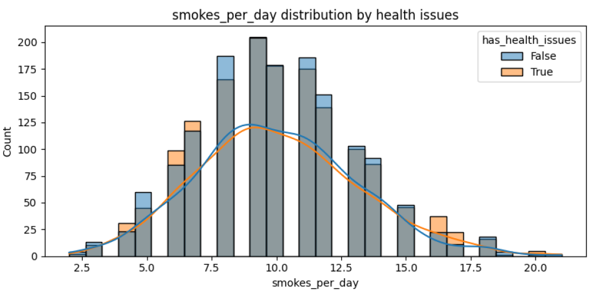
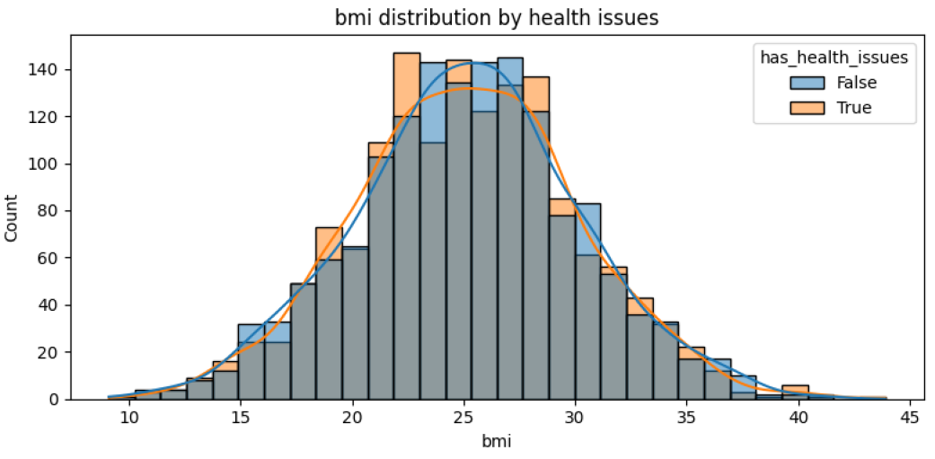
Methodology: Exploratory Data Analysis (EDA)
Target Distribution: Analyzed balance of has_health_issues (true/false).
Numeric Feature Distributions: Age, BMI, smokes/drinks per day vs. health issues.
Categorical Feature Distributions: Gender, mental health, diet quality vs. health issues.
Correlations: Identified linear relationships between numerical variables.
5
Notes:
In this slide, we show the EDA: Target Distribution: Analyzed the balance of 'has_health_issues' (true/false).
Numeric Feature Distributions: Examined relationships between numerical features (e.g., age, BMI, smokes/drinks per day) and health issues.
Categorical Feature Distributions: Explored how health issues vary across categories (e.g., gender, mental health status, diet quality).
Correlations: Identified potential linear relationships between numerical variables. These two graphs show the distribution of smoking frequency and BMI, grouped by whether individuals have health issues. We can observe that higher smoking rates slightly correlate with more health problems. For BMI, the distribution is centered around 25, but individuals with health issues appear more frequently at both lower and higher BMI extremes, suggesting potential risk at both ends.

Slide 6
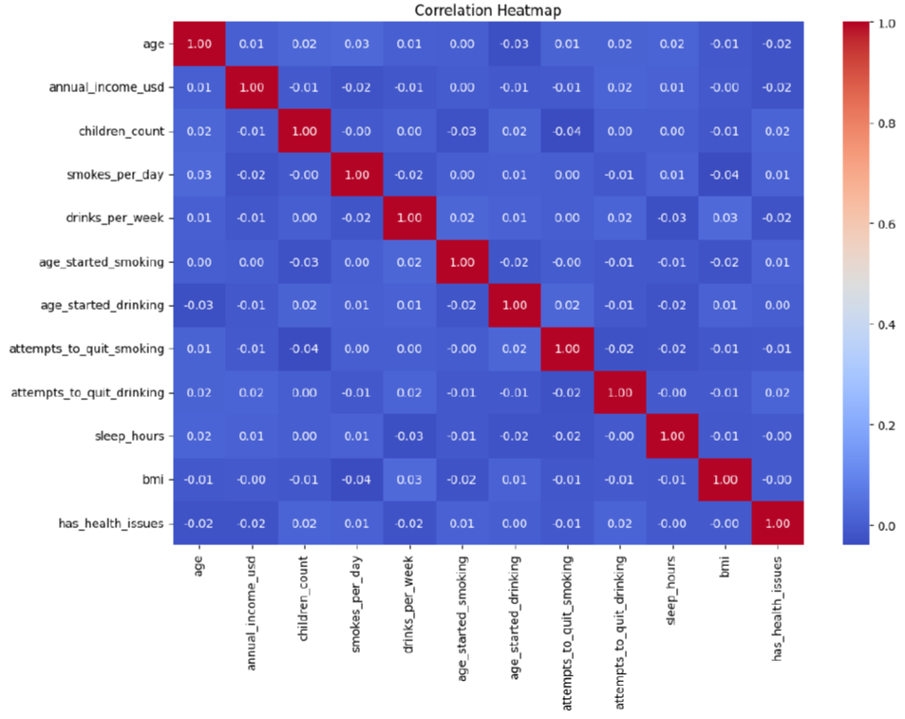
EDA: Insights & Patterns
Understanding underlying data patterns was critical.
Examined target variable balance and feature distributions.
Visualized relationships for numerical and categorical factors.
Insights on how factors like age, BMI, habits influence health.
Noted higher children counts & quit attempts in health issue group.
6
Notes:
Our next step was Exploratory Data Analysis, or EDA, which helped us uncover patterns in the data. We started by checking the balance of our target variable, has_health_issues, to understand the proportion of individuals with and without health issues. Then, we analyzed numeric features like age, BMI, and smoking or drinking habits using histograms, which showed trends related to health status.
For categorical features like gender, mental health, and diet quality, we used count plots to compare distributions. We also ran correlation analysis to detect meaningful linear relationships. One insight we found was that people with health issues tended to report more children and a higher number of attempts to quit drinking.

Slide 7
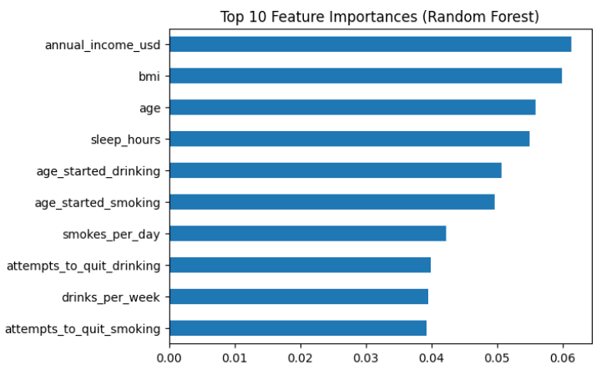
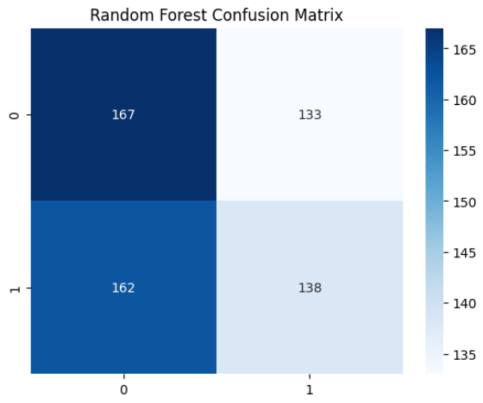
Predictive Modeling & Key Results
Model Selection: Logistic Regression, Classification Trees.
Feature Engineering: Categorical encoding, numerical scaling.
Evaluation Metrics: Accuracy, Precision, Recall, F1-Score, ROC AUC.
Key Predictors: smokes_per_day, bmi, age.
Model Performance: Logistic Regression: 49% accuracy (AUC ~0.51). Random Forest: 51% accuracy (AUC ~0.50). Performance is close to random guessing, indicating lack of meaningful classification.
7
Notes:
In the next slide we show the Predictive Modeling and Key results: Model Selection: Logistic Regression and Classification Trees (briefly mention why – e.g., interpretability, suitability for binary classification).
Feature Engineering: Encoding categorical variables, scaling numerical features.
Evaluation Metrics: Accuracy, Precision, Recall, F1-Score, ROC AUC.
Key Predictors: Highlight 2-3 most influential features (e.g., smokes_per_day, bmi, age).
Model Performance: Summarize best model's performance.
The top chart shows the most important features in our Random Forest model annual income, BMI, and age were the strongest predictors. The confusion matrix below shows a balanced performance, though the model struggles slightly with distinguishing between the two classes, as seen by the misclassifications in both directions."

Slide 8
Results & Conclusion
1.
2.
3.
Key Health Risk Factors:
behavior, demographic etc
Moderate Predictive Power using ML algorithms
Low Model Accuracy –
close to guess
4.
5.
Feature Importance Insights:
smokes_per_day, bmi, age
Need for Better Data –
lacked depth or quality
8
Notes:
Using a logistic regression model, we aimed to identify key factors linked to health problems. The model lacked predictive power, but managed to identify the most influential variables, such as smokes_per_day, bmi, age as key risk factors. (showed in the previous slide).
To validate and compare results, we also applied a Random Forest model. However, both models showed relatively low predictive performance, with AUC scores around 49% for logistic regression and 51% for Random Forest—barely better than random guessing. This can be seen clearly in the ROC curve.
Digging deeper, the Confusion Matrix (previous slide) reveals that the Random Forest model misclassified both positive and negative cases at nearly equal rates. This reinforces the conclusion that, despite identifying relevant features, the models themselves struggled to accurately predict outcomes.
These results highlight both the promise and limitations of predictive models in health analytics—and the need for richer, more detailed data to drive better results.

Slide 9
Thank you for your attention!
We are now open for any questions.

